Slide 1
Matchability (part 2)
July 26, 2019

Slide 2
Overview
Philosophy behind the matchability algorithm
SQL Extraction
Cleaning & Formatting
Manipulations, Features, New Variables
Modelling
Analysis
Next Steps
Appendix & Documentation

Slide 3
Philosophy
Identify the end goal to be to consistently predict whether an opportunity will find a match or not.
To do so we must:
Extract, clean, trim, format, manipulate, and expand the data efficiently.
Identify the features which generate the most reliable and accurate predictions.
Produce a detailed and commented script.
All in one single file: matcha.py

Slide 4
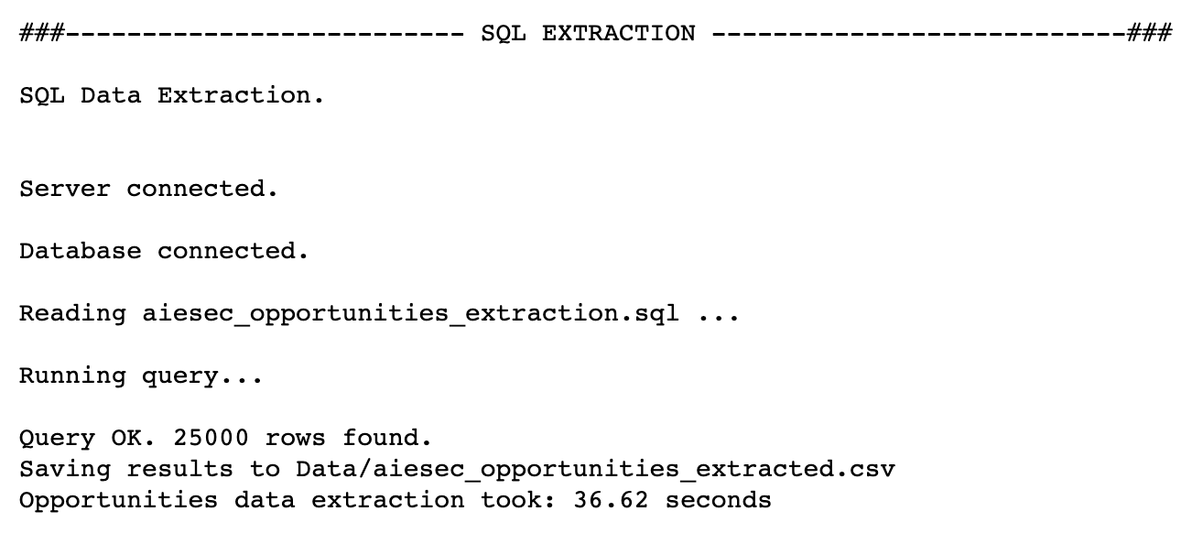
Extracting the features
opportunities
programmes
opportunity_applications
offices
people

Slide 5
Cleaning
Filtering
Openings threshold.
Opportunities with status “open”.
Trimming
Dropping duplicate opportunity_id rows.
Replacing infinite values with NaN.
Formatting
Date formatting for columns: created_at, applications_close_date, earliest_start_date, latest_end_date.
On average, around 12-18% of the originally extracted data is formatted and/or dropped.

Slide 6
Features 1 of 2
New variables as discussed on June 21st.
Title length
Year completion ratio
Description length
Number of languages
Salary
Is food provided
HDI
Programme type
Pro: computing and merging fast and efficient.

Slide 7
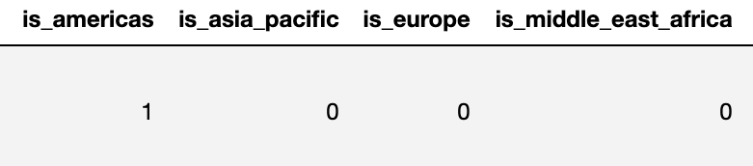
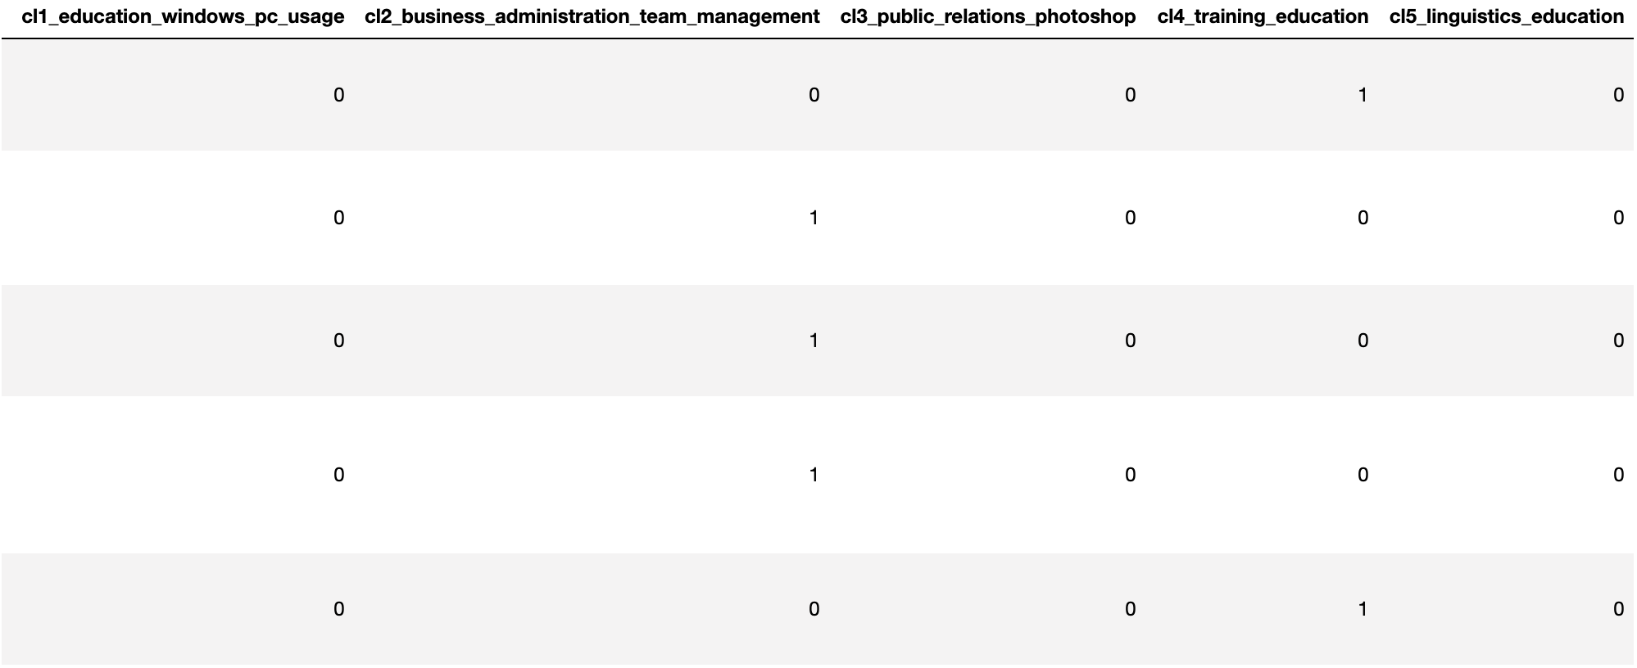
Features 2 of 2
We also add other ”one-hot encoded” variables.
Regions
Job Description
“1” is encoded in the proper column for that opportunity, the rest are zeros.
Merge the columns: opp_skill_req, opp_skill_pref, opp_background_req, opp_background_pref into a skills column
skills
is_americas
is_europe
is_asia_pacific
is_middle_east_africa
Perform a text analysis on the skills column. (K-Means)

Slide 8
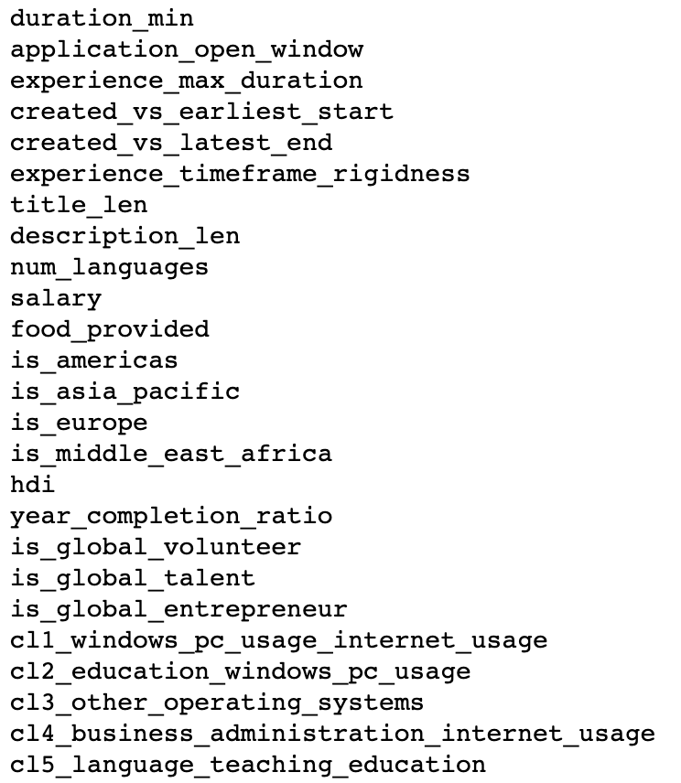
Modelling
Features of interest:
To understand the data, we applied a logistic regression and fitted a decision tree.
Let’s take a look...

Slide 10
: controllable features

Slide 11
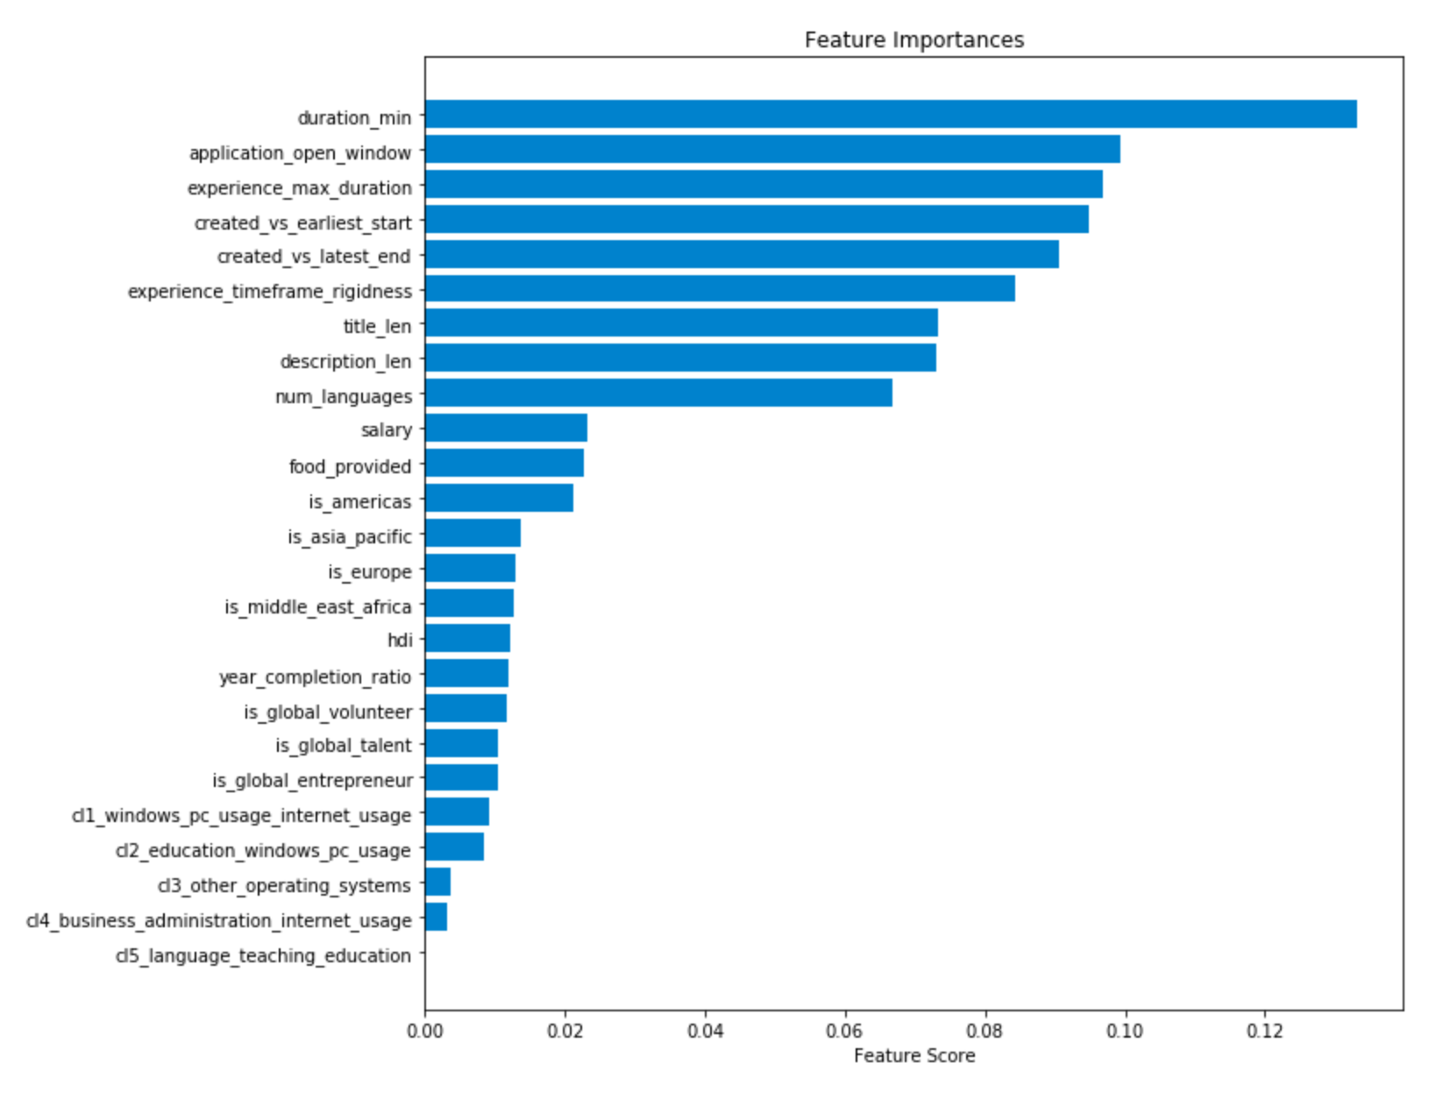
Modelling

Slide 12
Modelling
context
benefits
location
content

Slide 13
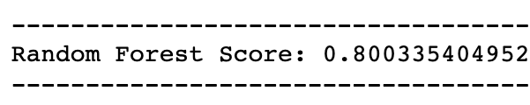
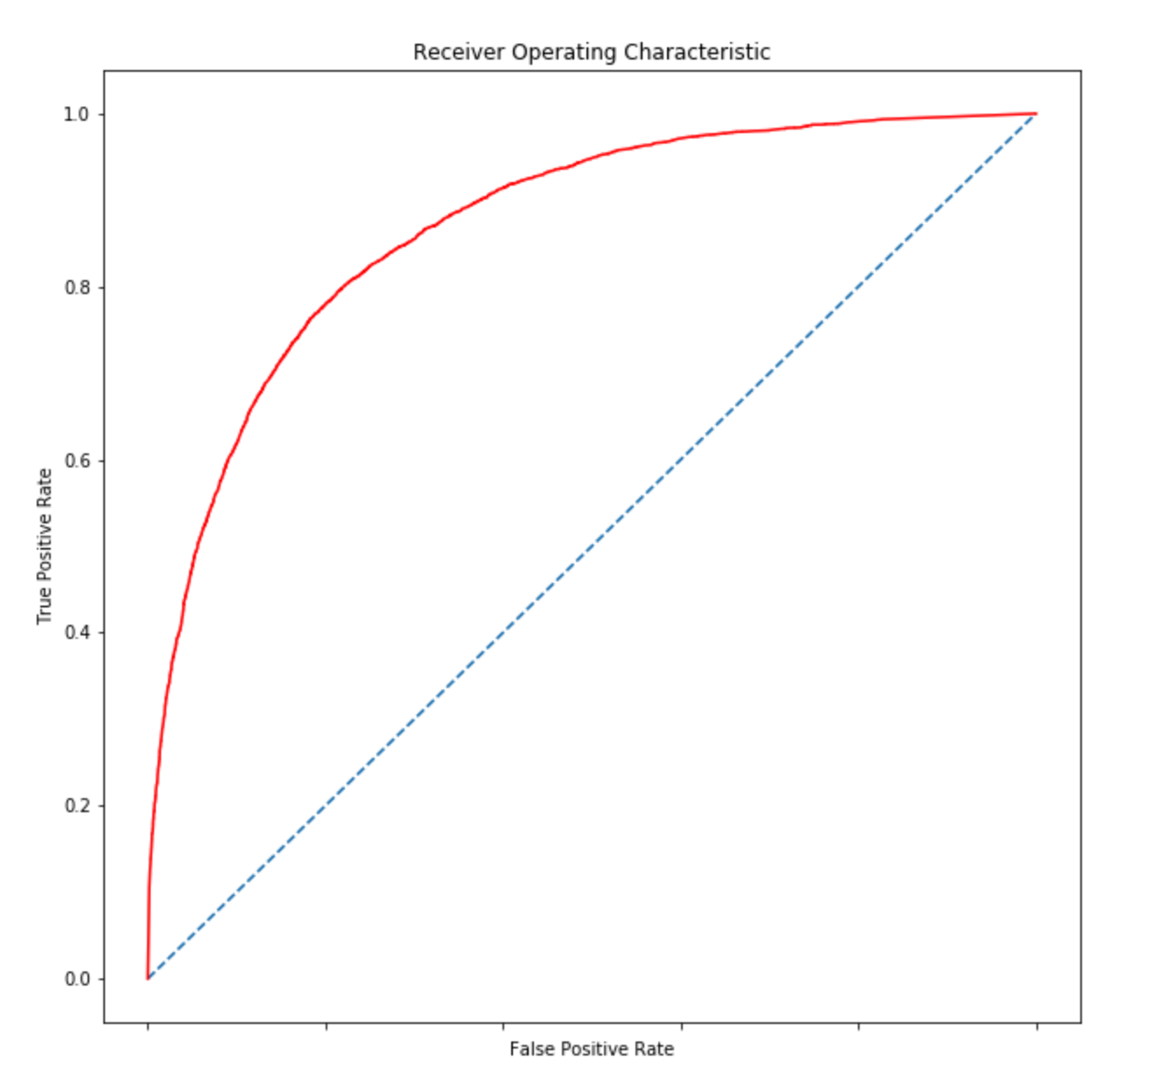
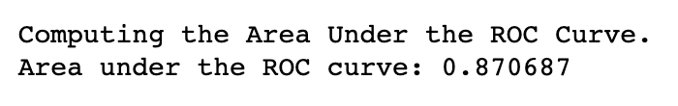
Analysis 1 of 2
Model predicts correctly 80% of the time.
Reliability of the model shown by the ROC curve.
Random Forest Classifier takes 5.5 seconds to be trained given around 70k entries.

Slide 14
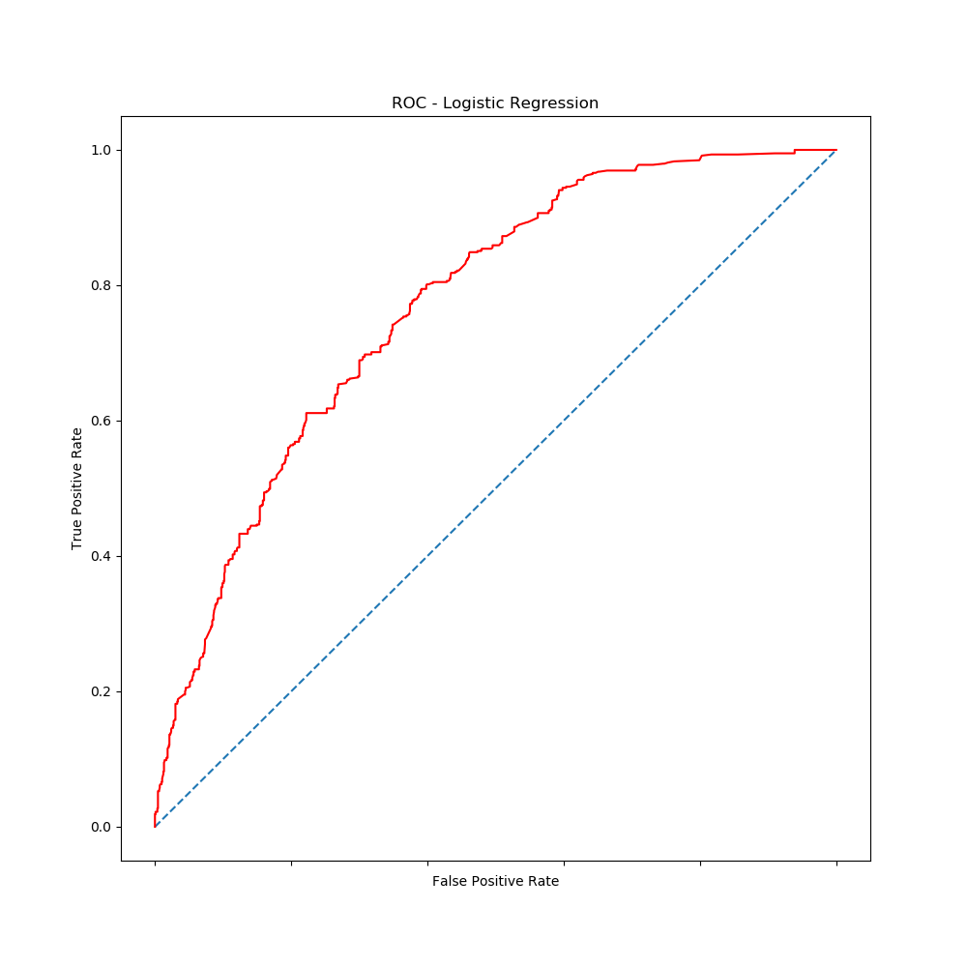
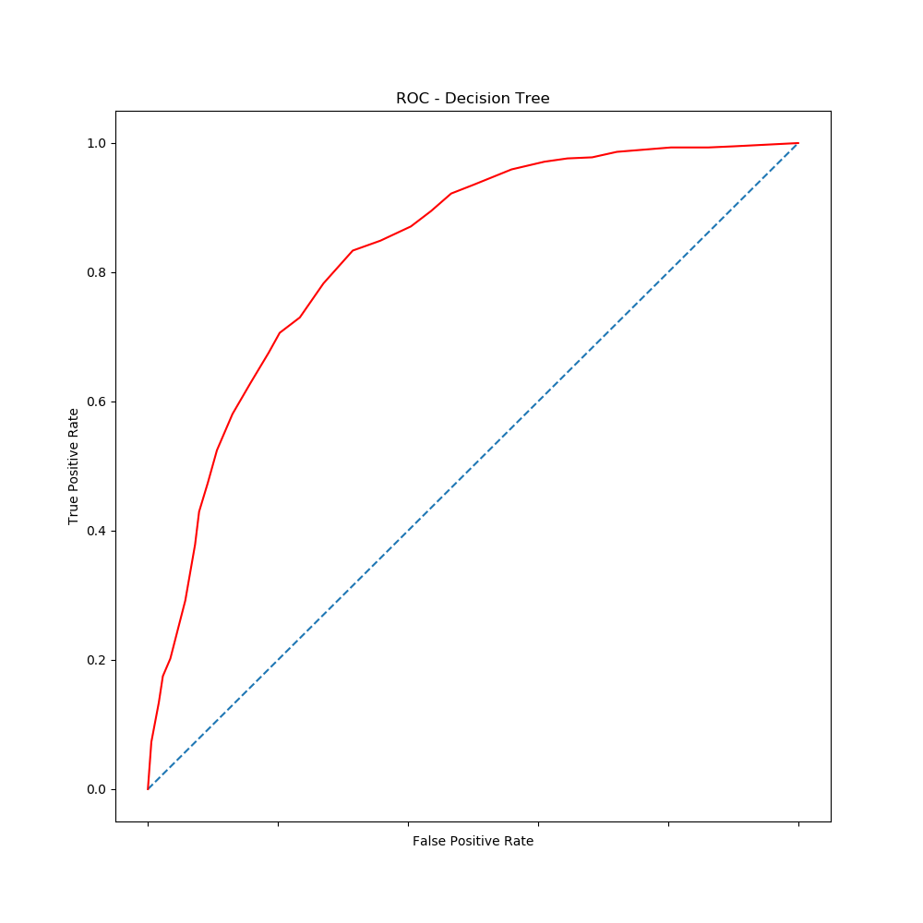
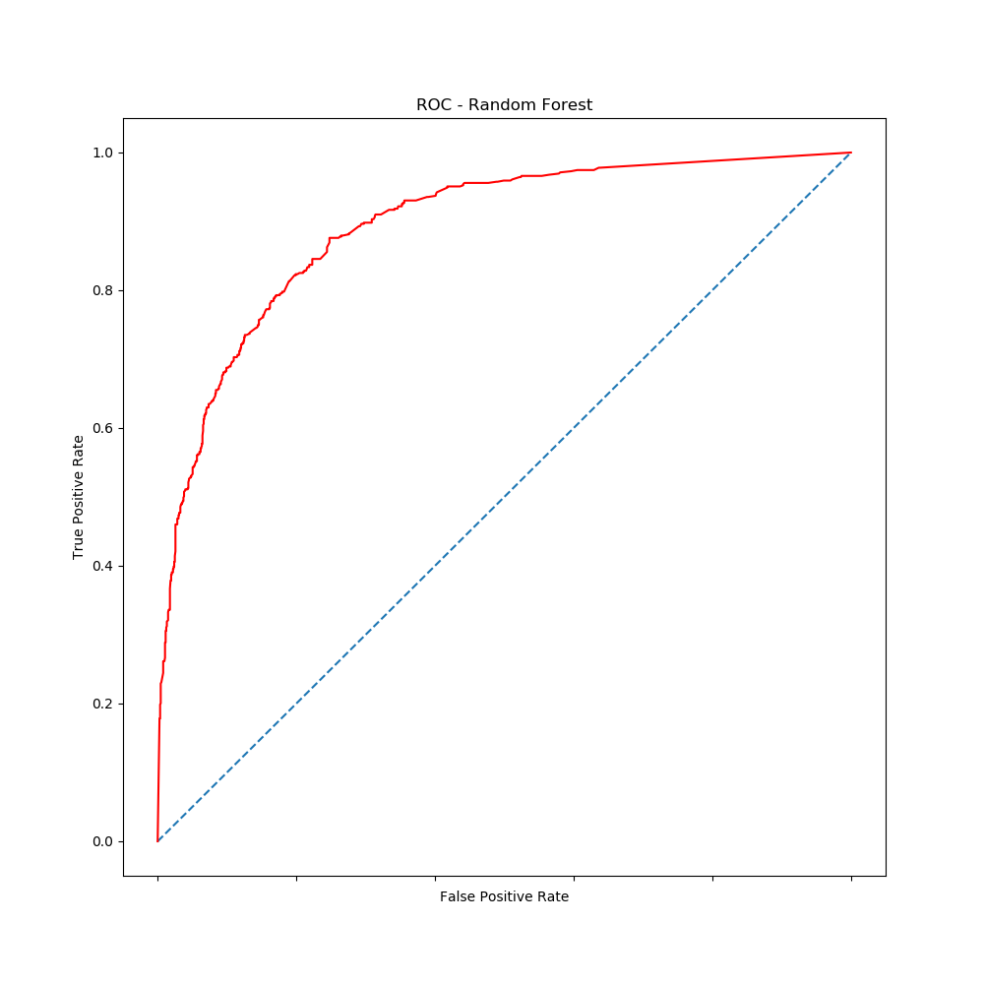
Analysis 2 of 2
Interestingly, this does not appear to be linear problem...

Slide 15
Next Steps
What do we have now?
A reliable model which can predict whether a newly created opportunity will found matches or not.
What to do now?
Need to discuss how the data will be inputted into the model and in which format.
Recommendations from us?
Probably a good idea to retrain the model every month or so as an automated cron job.

Slide 16
Appendix

Slide 17
Appendix
Table of contents
Section Page
Imports .............................................................................................................................. 1
Helper functions ................................................................................................................. 2
SQL Extraction ................................................................................................................... 4
Fetching Data Locally ......................................................................................................... 5
Data Cleaning, Filtering, Trimming ...................................................................................... 6
Data Manipulations
Extracting Variables of Interest ........................................................................ 7
Text Analysis of Job Description ....................................................................... 8
Expanding by Openings ................................................................................... 9
Modelling
Logistical Regression ...................................................................................... 10
Decision Tree Classifier ................................................................................... 11
Random Forest Classifier ................................................................................ 12
Analysis
Classification Rates, ROC curves .................................................................... 13

Slide 18
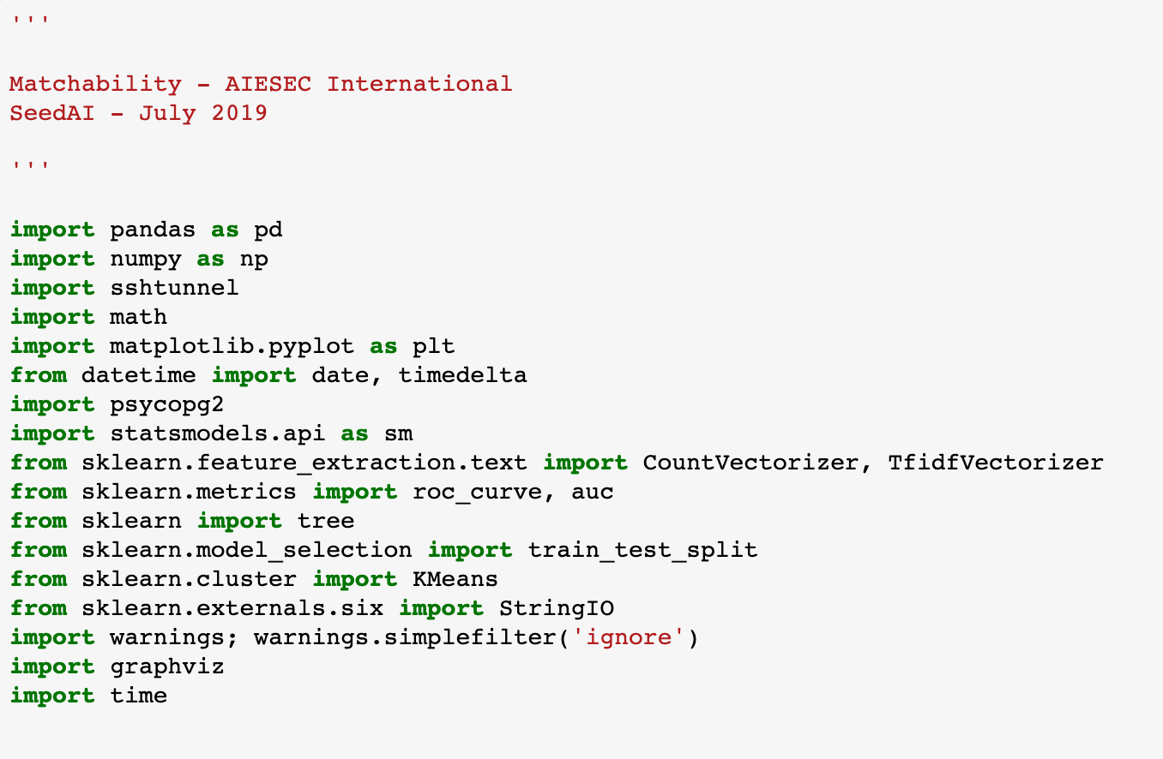
1
Imports
Importing the data analytics essentials: Pandas & Numpy.
SSHTunnel for connecting to the remote AIESEC server using the private key file (.pem file located in the same working directory).
Psycopg2 for connecting to the PostgreSQL Database.
Sklearn: CountVectorizer, TfidfVectorizer, Kmeans → used for the job description text mining.
Sklearn: roc_curve, auc, tree, train_test_split, StringIO → used for decision tree and model analysis.
Statsmodels: using the Logistical Regression method from the library.
Graphviz: used to visualize the decision tree.
Importing the time module to measure code’s efficiency.

Slide 19
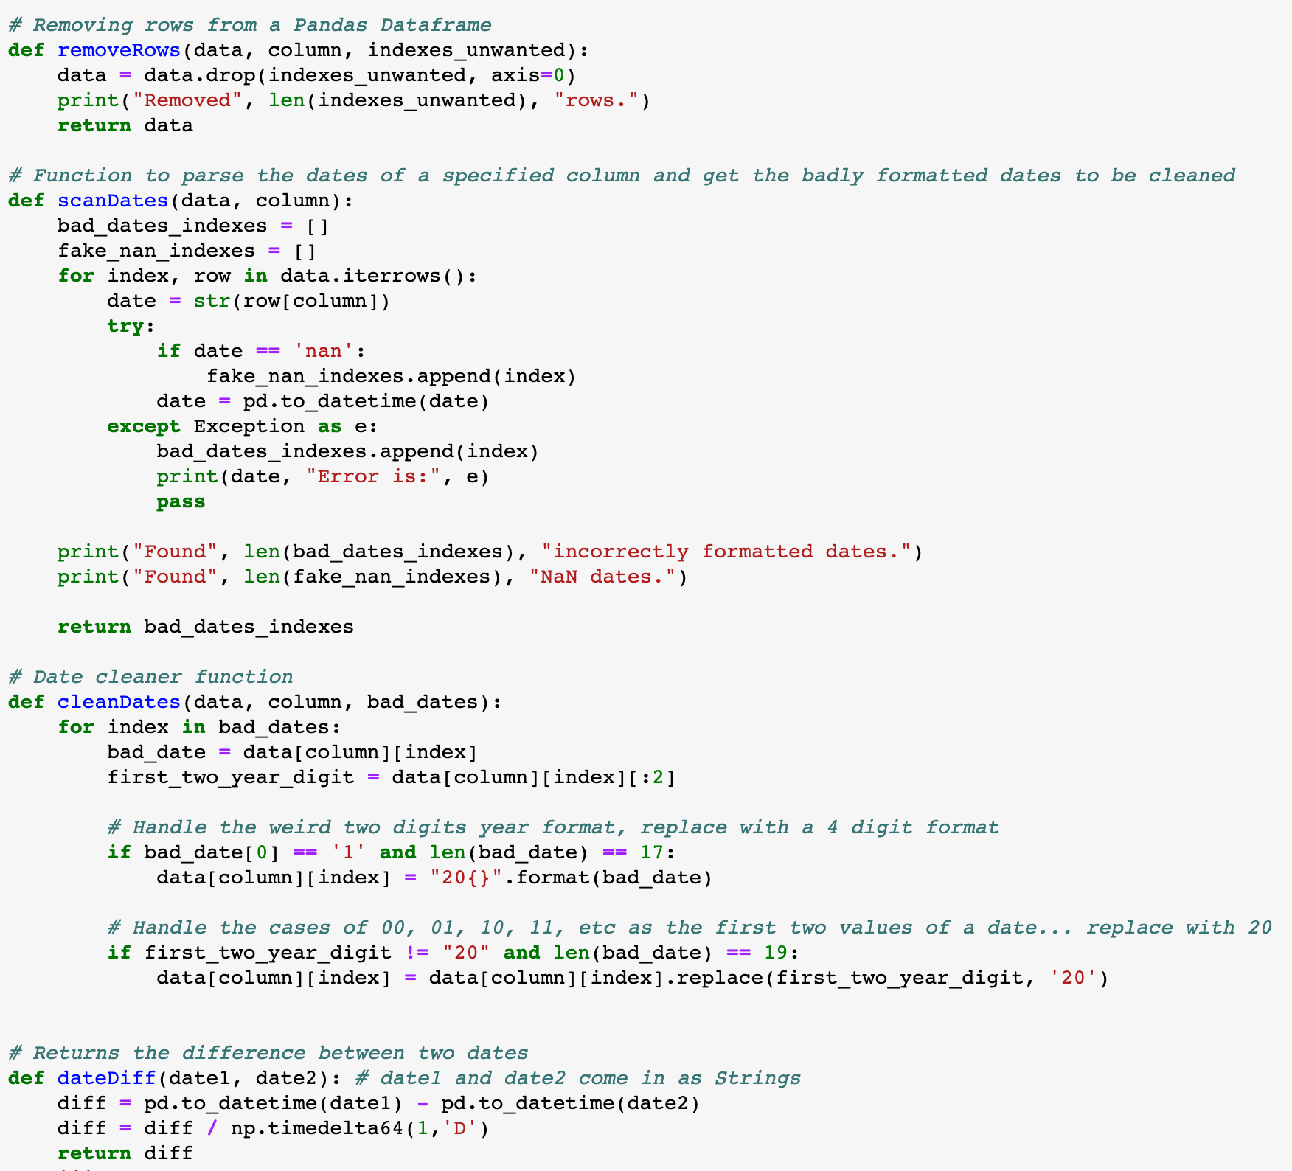
2
Helper Functions (1/2)
removeRows() function used to drop some rows from a Pandas dataframe. Required to pass the dataframe object, the target columns and the list of unwanted indexes.
scanDates() function iterates over a given dataframe object on a specified column and records all date strings which are either “NaN” or that cause an error when being converted to a panda datetime object.
cleanDates() function is called after the scanDates() function and attempts to format the dates picked up by scanDates(). Typical formatting errors include having a two year digit format instead of a 4 digit format or having an incorrect thousands value for the year (i.e.: 1014, instead of 2014)
dateDiff() function simply computes the difference between two Panda datetime objects and returns the result in days.

Slide 20
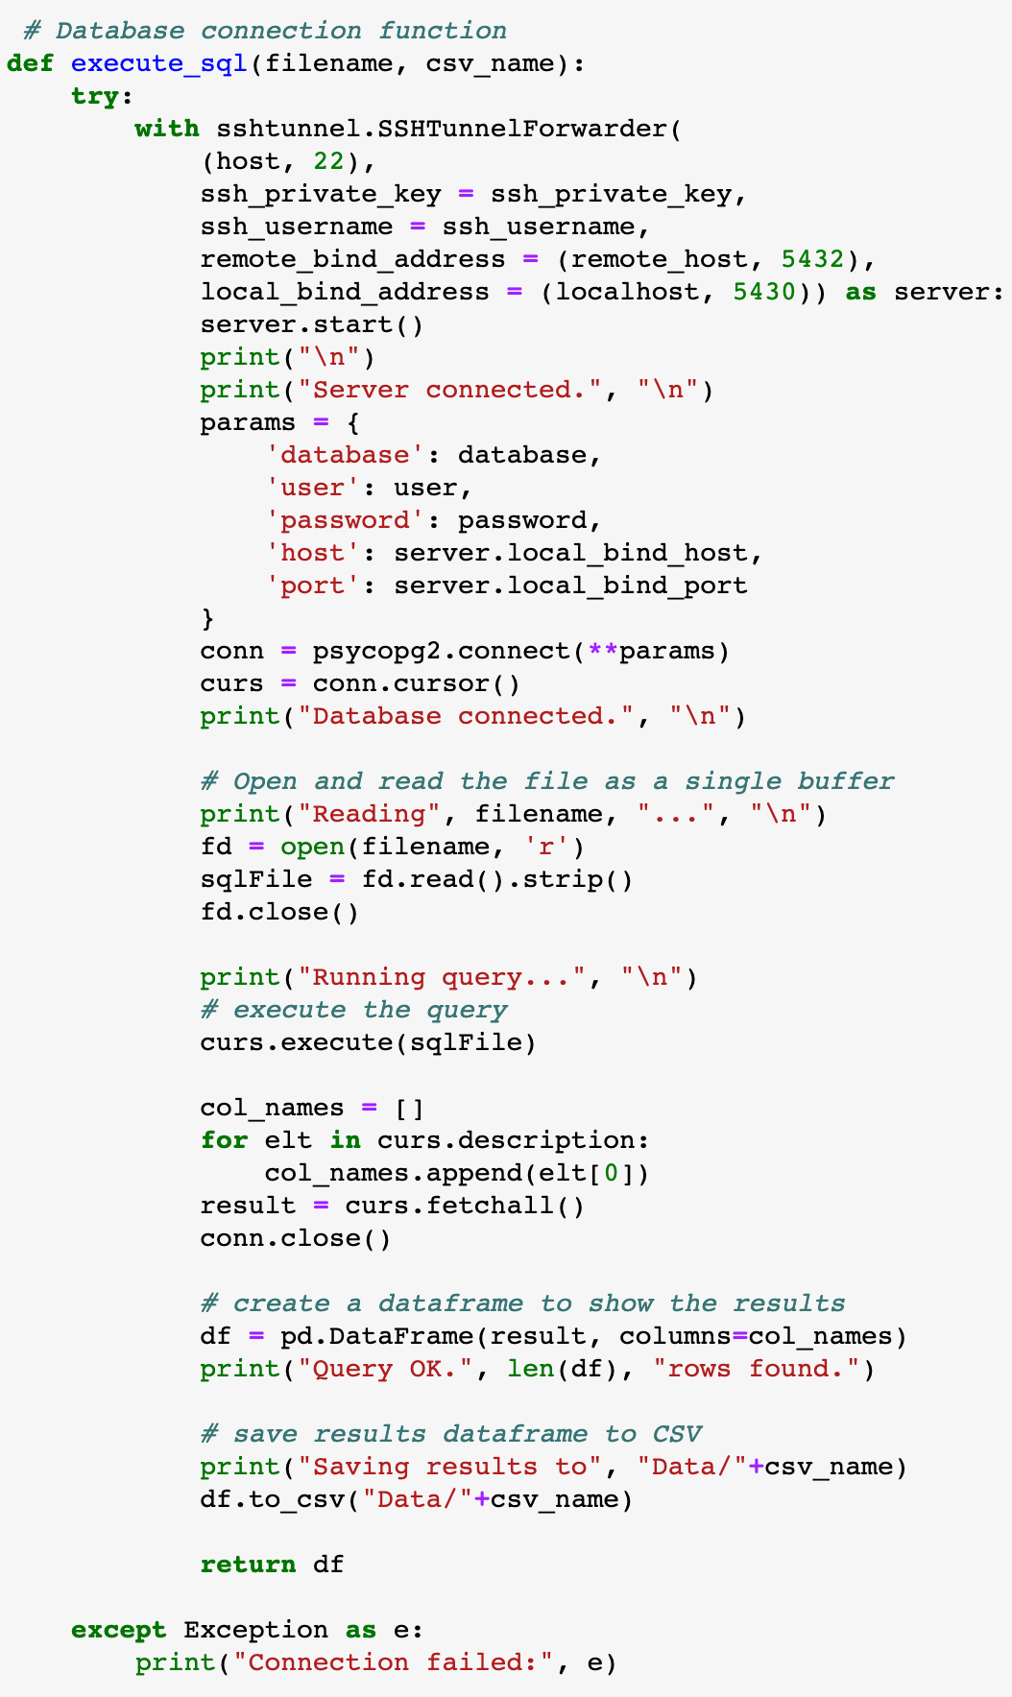
3
Helper Functions (2/2)
execute_sql() function is used to connect to the remote AIESEC server and the and database. The parameter filename refers to the .sql script to execute from the current working directory and the csv_name parameter is the name the will be given to the generated table from the data extraction, also stored in the current working directory.
(See next page for the initialization of the connection variables: ssh_private_key, ssh_username, remote_host, localhost, database, password, etc.)
Connect to server.
Connect to the database.
Open the external .sql extraction script.
Remove whitespaces around the script, just in case.
Execute the script.
Construct a new Pandas dataframe with the query results by iterating over the curs.description results object.
Close the database connection.
Create the dataframe from the results and the column names.

Slide 21
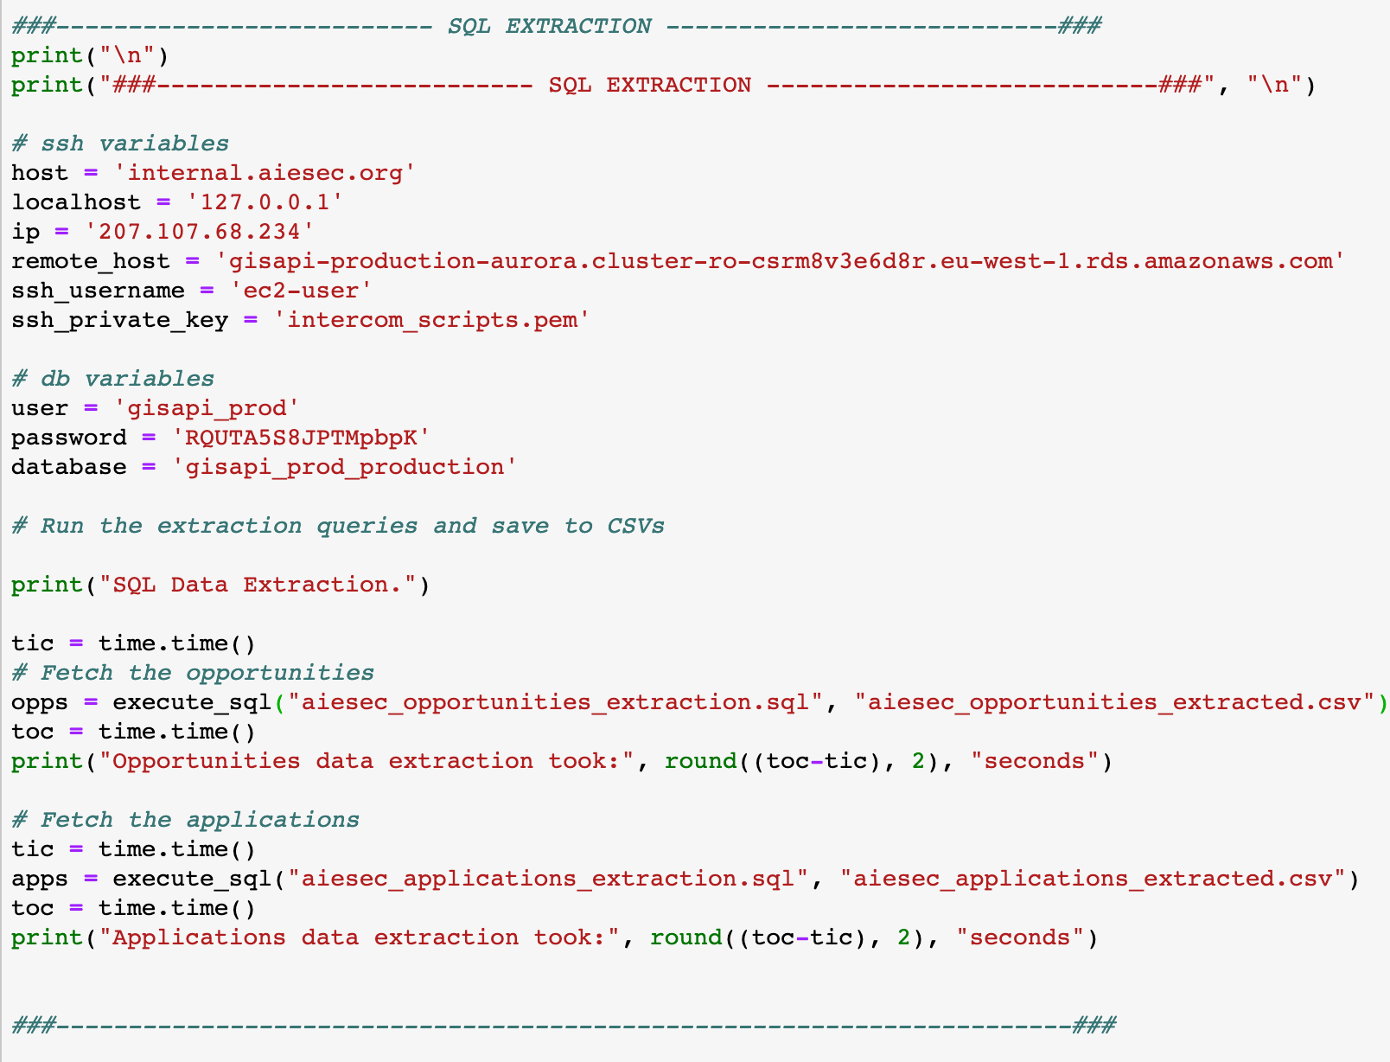
4
SQL Extraction
The connection parameters are listed here.
Make sure the private key (.pem) file is in the same working directory as the main matcha.py file.
We call the execute_sql() function once for the opportunities data extraction, passing it the specified parameters. We measure the execution time.
We do the same for the applications, holding our target variable.
In both these extractions, a CSV file is saved locally.

Slide 22
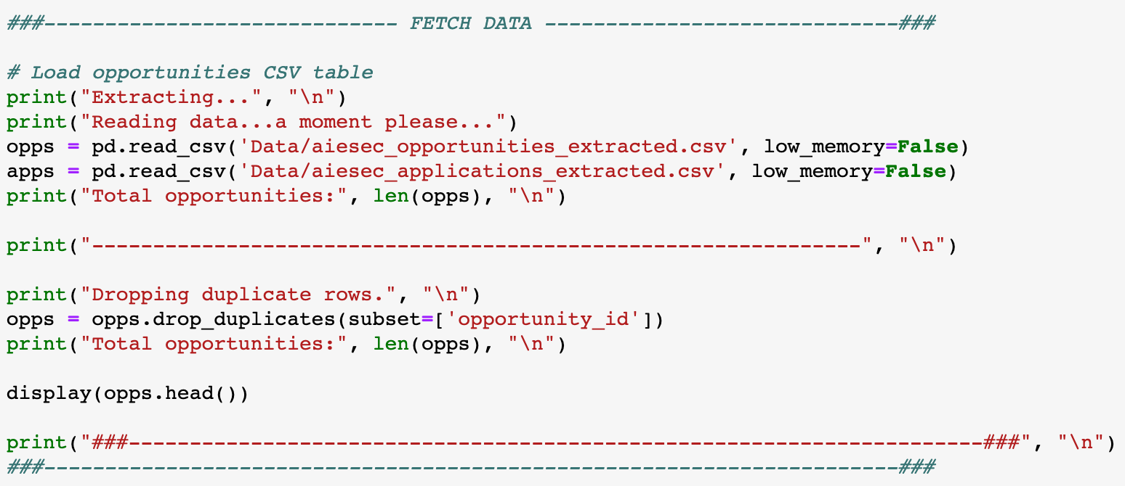
5
Fetching Data Locally
Load the local CSV files using the common Pandas read_csv() function. the low_memory parameter is not deprecated yet nor essential but is still specified.
For more details: https://stackoverflow.com/questions/24251219/pandas-read-csv-low-memory-and-dtype-options
Remove duplicates rows from the opportunities dataframe (opportunity_id columns as the unique identifier).

Slide 23
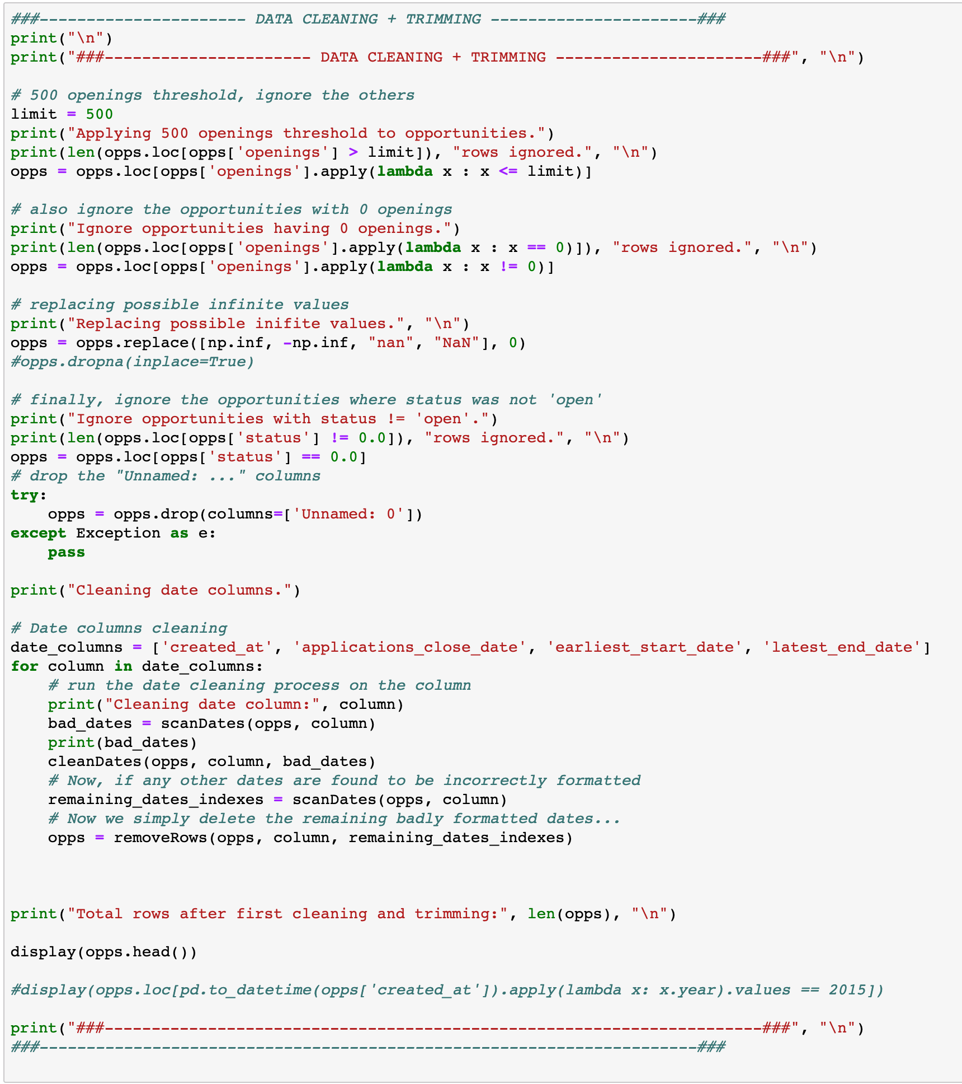
6
Data Cleaning, Filtering, Trimming
Filter only the opportunities with 500 openings or less.
Make sure we have no opportunities with zero openings.
Now, filter only the opportunities which have a status equal to “0.0”, meaning “open”.
When generating the dataframe during the extraction, a “Unnamed: 0” column gets added automatically, we simply remove it.
Specifying which date columns we want to scan and clean (as explained previously).
Iterating over the columns.
Scanning.
Cleaning.
Scanning again. The rows which are recorded here will simply get removed since this means there is no safe way of formatting them.

Slide 24
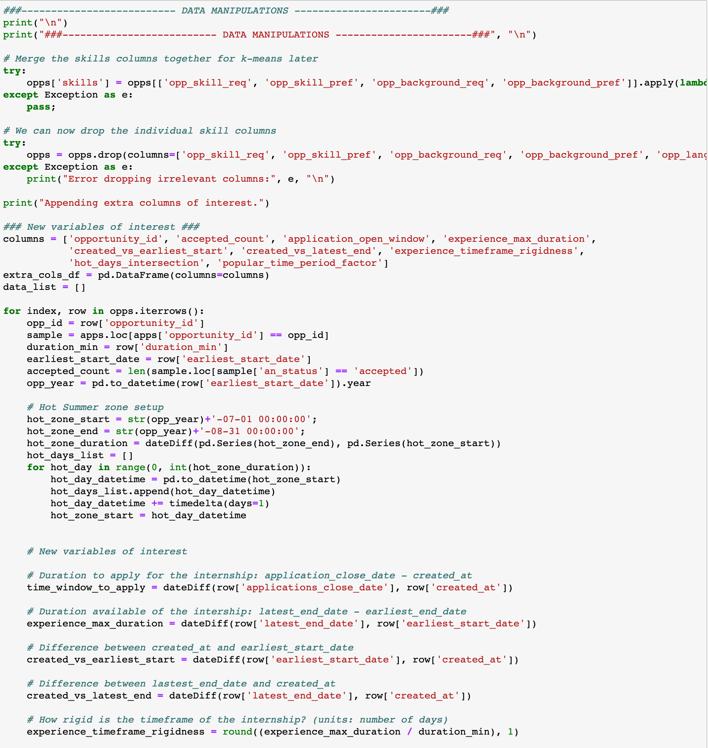
7
Data Manipulations - Extracting Variables of Interest
Merge/Join the specified (list format) columns into one skills column.
Remove the columns after the merge, useless now.
Define the column names of the new variables (part of them).
Iterate over each opportunity row.
The “Hot Summer Zone” block is used to compute the number of days of the opportunity which intersect the months of July and August (popular months for internships).
Computing some date differences. Straightforward.

Slide 25
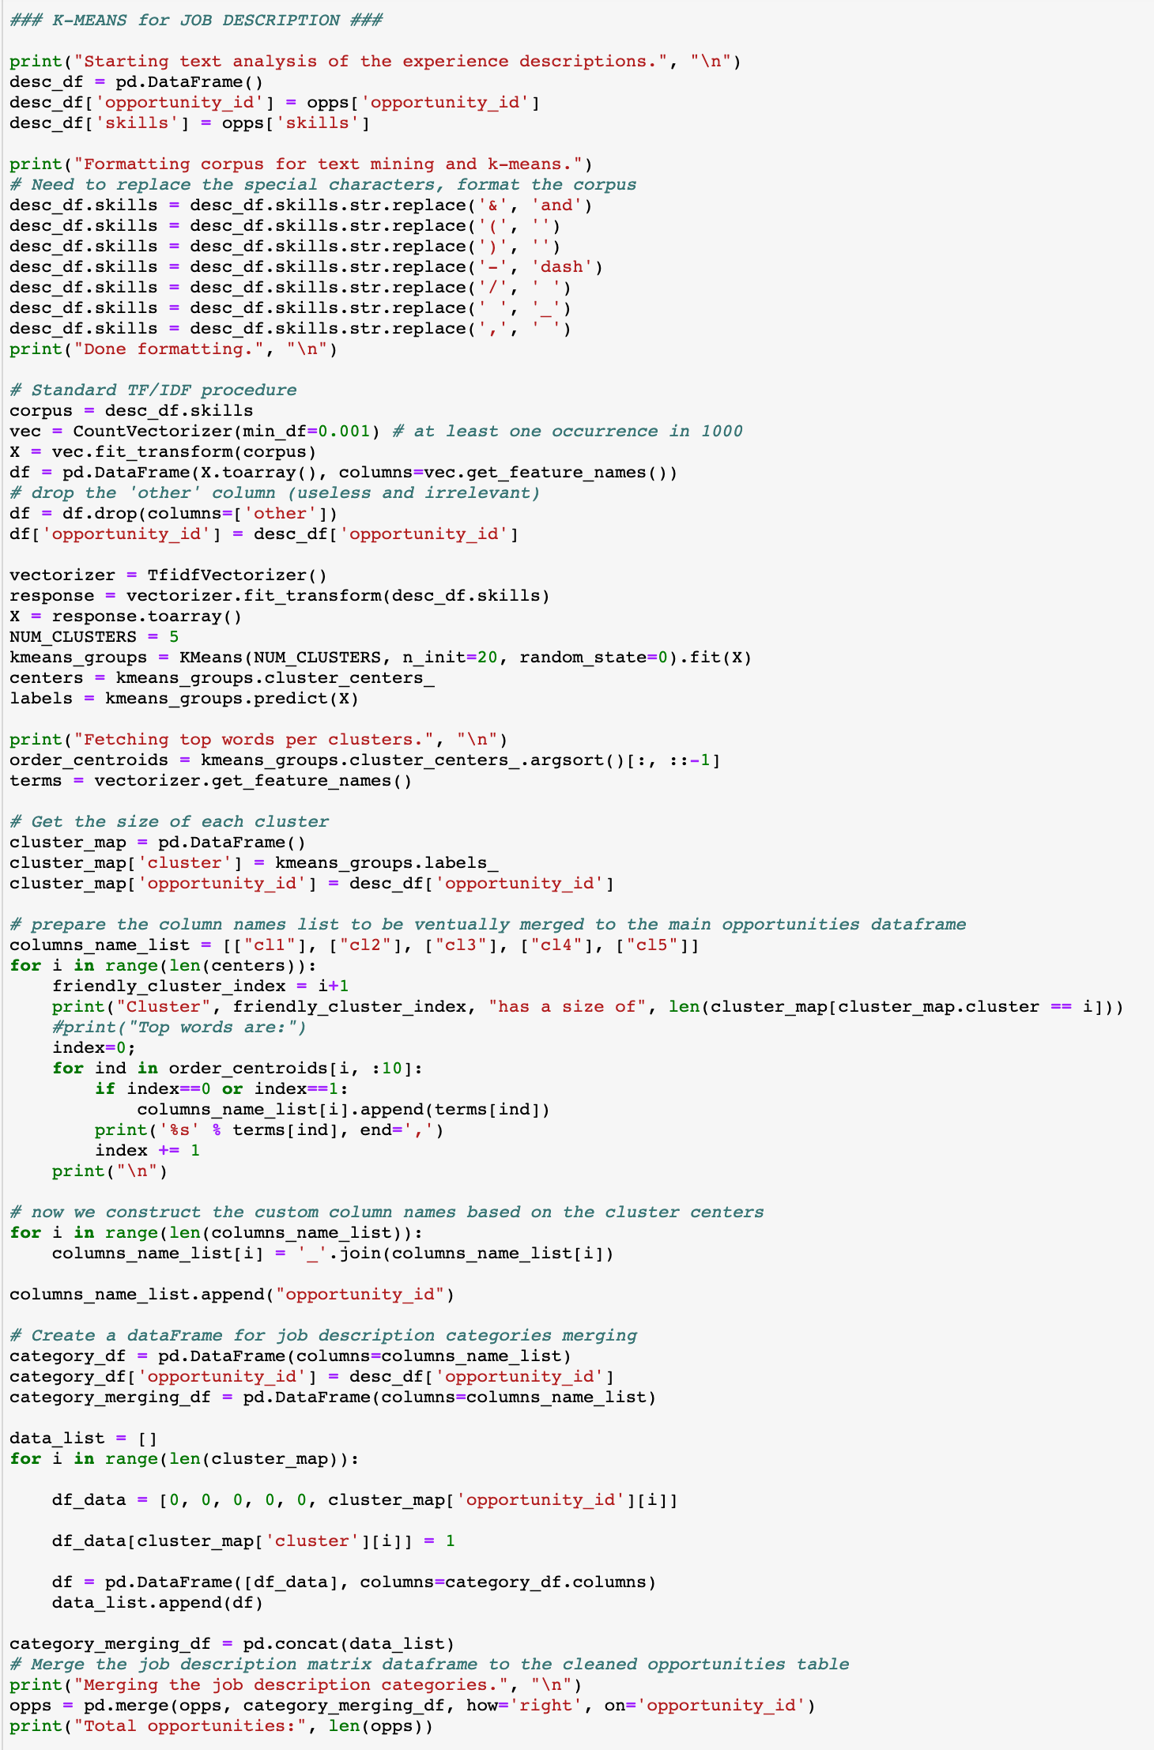
8
Data Manipulations - Text Analysis of Job Description
Create a new dataframe holding the opportunity_id and the skills string.
We format the skills corpus for textual analysis and kmeans clustering of job requirements.
We vectorize the words found the job description, based on their frequency.
We then compute the Term Frequency - Inverse Document Frequency which evaluates the importance of a word in a document.
For more details, visit: https://www.freecodecamp.org/news/how-to-process-textual-data-using-tf-idf-in-python-cd2bbc0a94a3/
Set our number of clusters/centers to 5. Call the sklearn kmeans function and fit it to the corpus.
We sort each center’s words by importance.
Now, we fetch the top words per cluster by iterating over each center, and then iterating over the first 10 words in each cluster.
To create the new columns, we append the first two words for each cluster onto a string either called “cl1”, “cl2”, ”cl3”, etc. referring to “cluster 1”, “cluster 2”, ”cluster 3”, etc. Overall, this generates columns like the following:
Here, we setup a temporary dataframe to be merged to the main opportunities dataframe.
We set the column names as shown above.
Then, we “one-hot encode” the proper column for each opportunity. This categorizes each opportunity by their type of background experiences required.
Finally, we merge the temporary dataframe to the main opportunities dataframe.
Printing out the length of the opportunities dataframe just by curiosity since the length should not have changed. If it has, an error occurred, could be due to duplicated rows or something else.

Slide 26
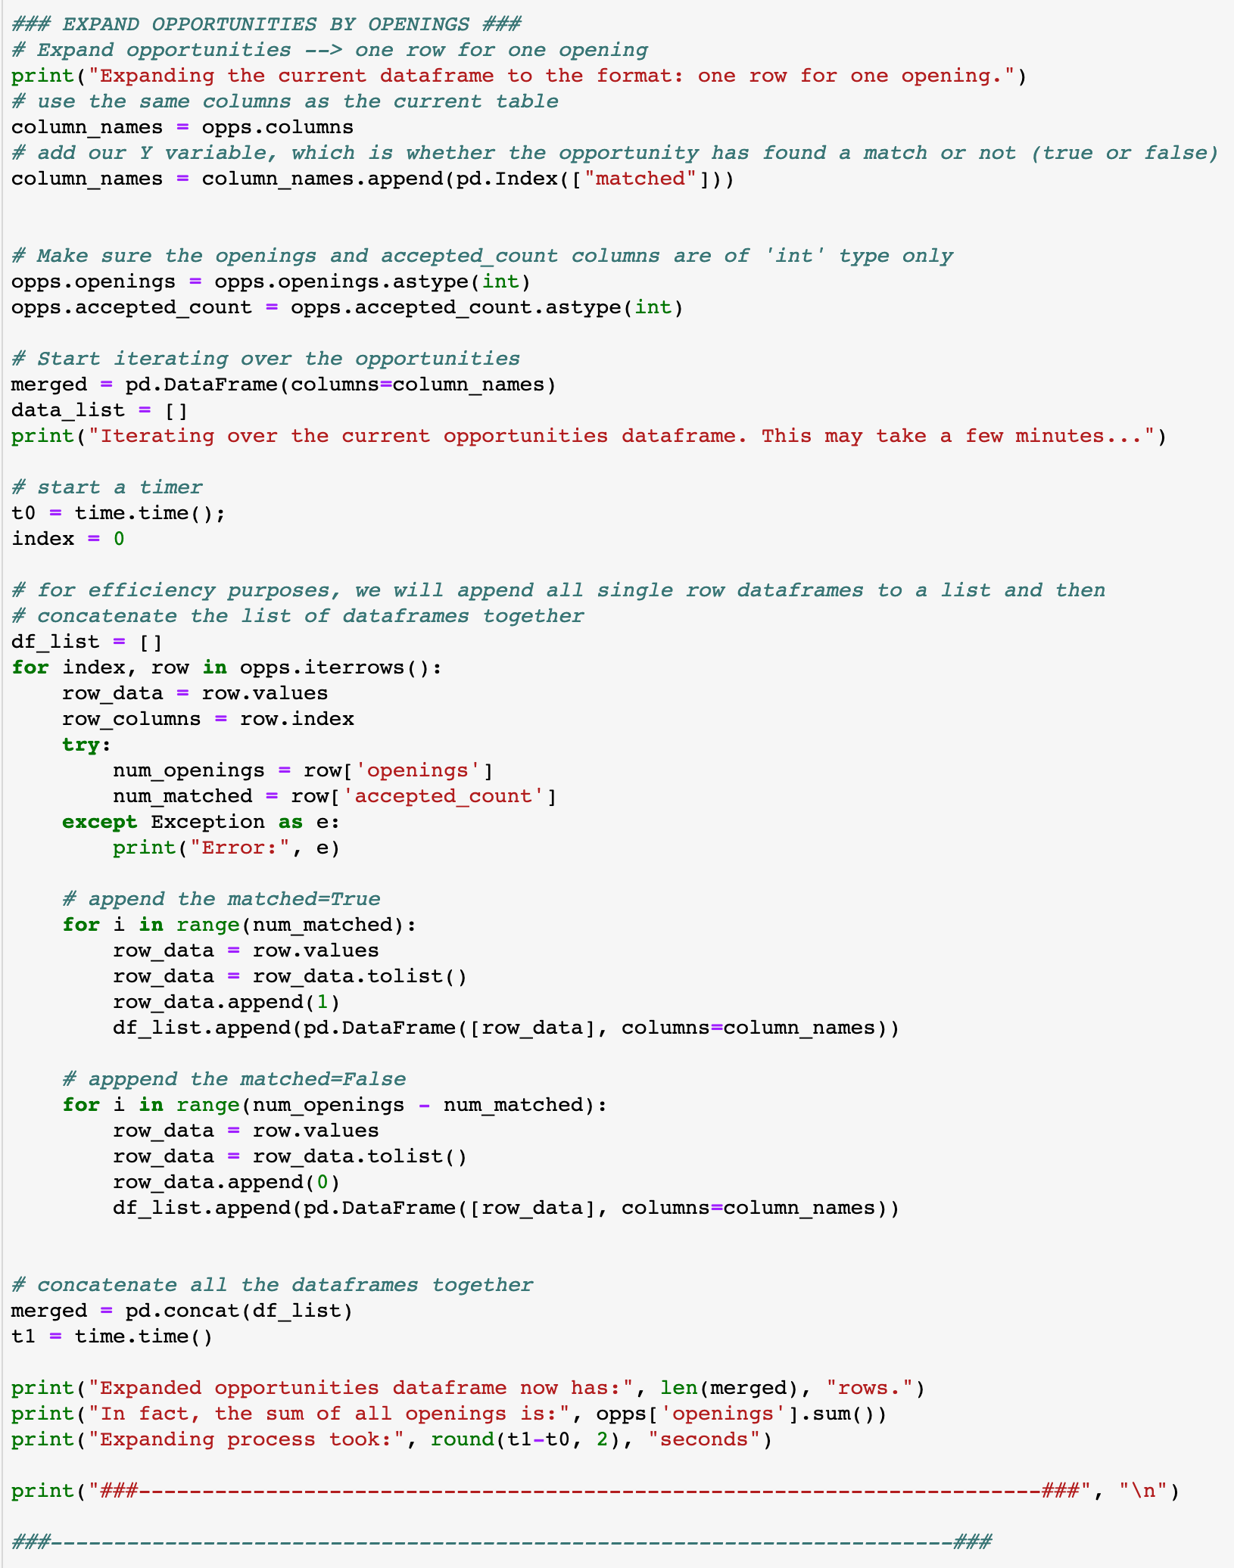
9
Data Manipulations - Expanding by Openings
Adding an extra “matched” column for our target variable (Y).
Create new variable merged which will hold the expanded opportunities dataframe.
We have to iterate over each opportunity.
Record the total openings for this opportunity.
Now, we have to loop a number of times equal to the number of accepted applicants for this opportunity, adding a ”1” in the matched column.
We repeat the same process, iterating (num_openings – num_accepted) times, adding a “0” in the matched column.
Note: The efficiency of the whole iteration described above is average-good. The idea is to create a list and append single line dataframes to it and then use the pd.concat() function to merge all the small dataframes together. For example, it requires around 20 seconds to receive a 5000 line expanded dataframe.

Slide 27
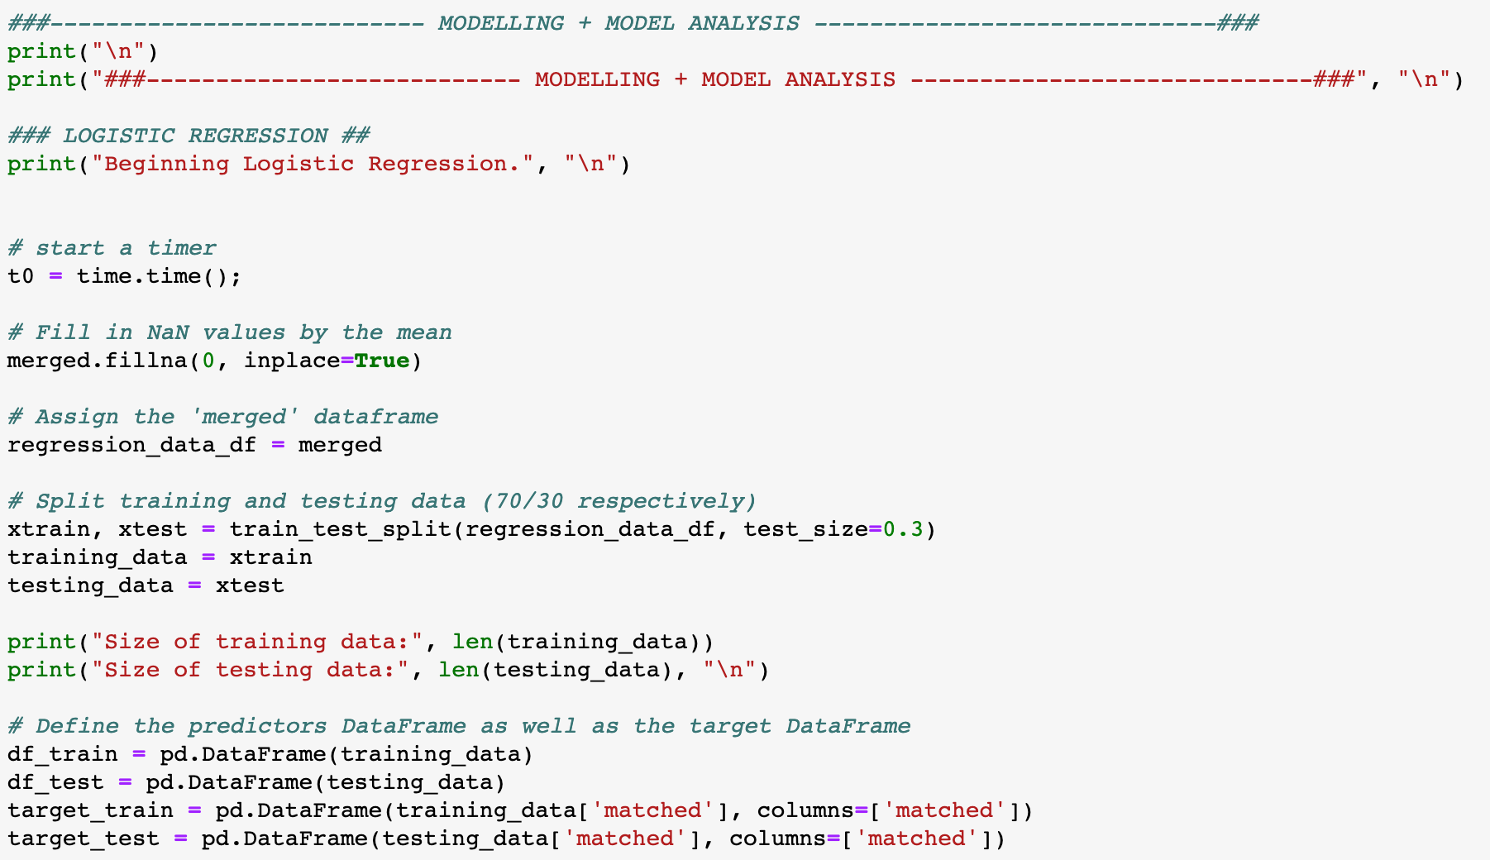
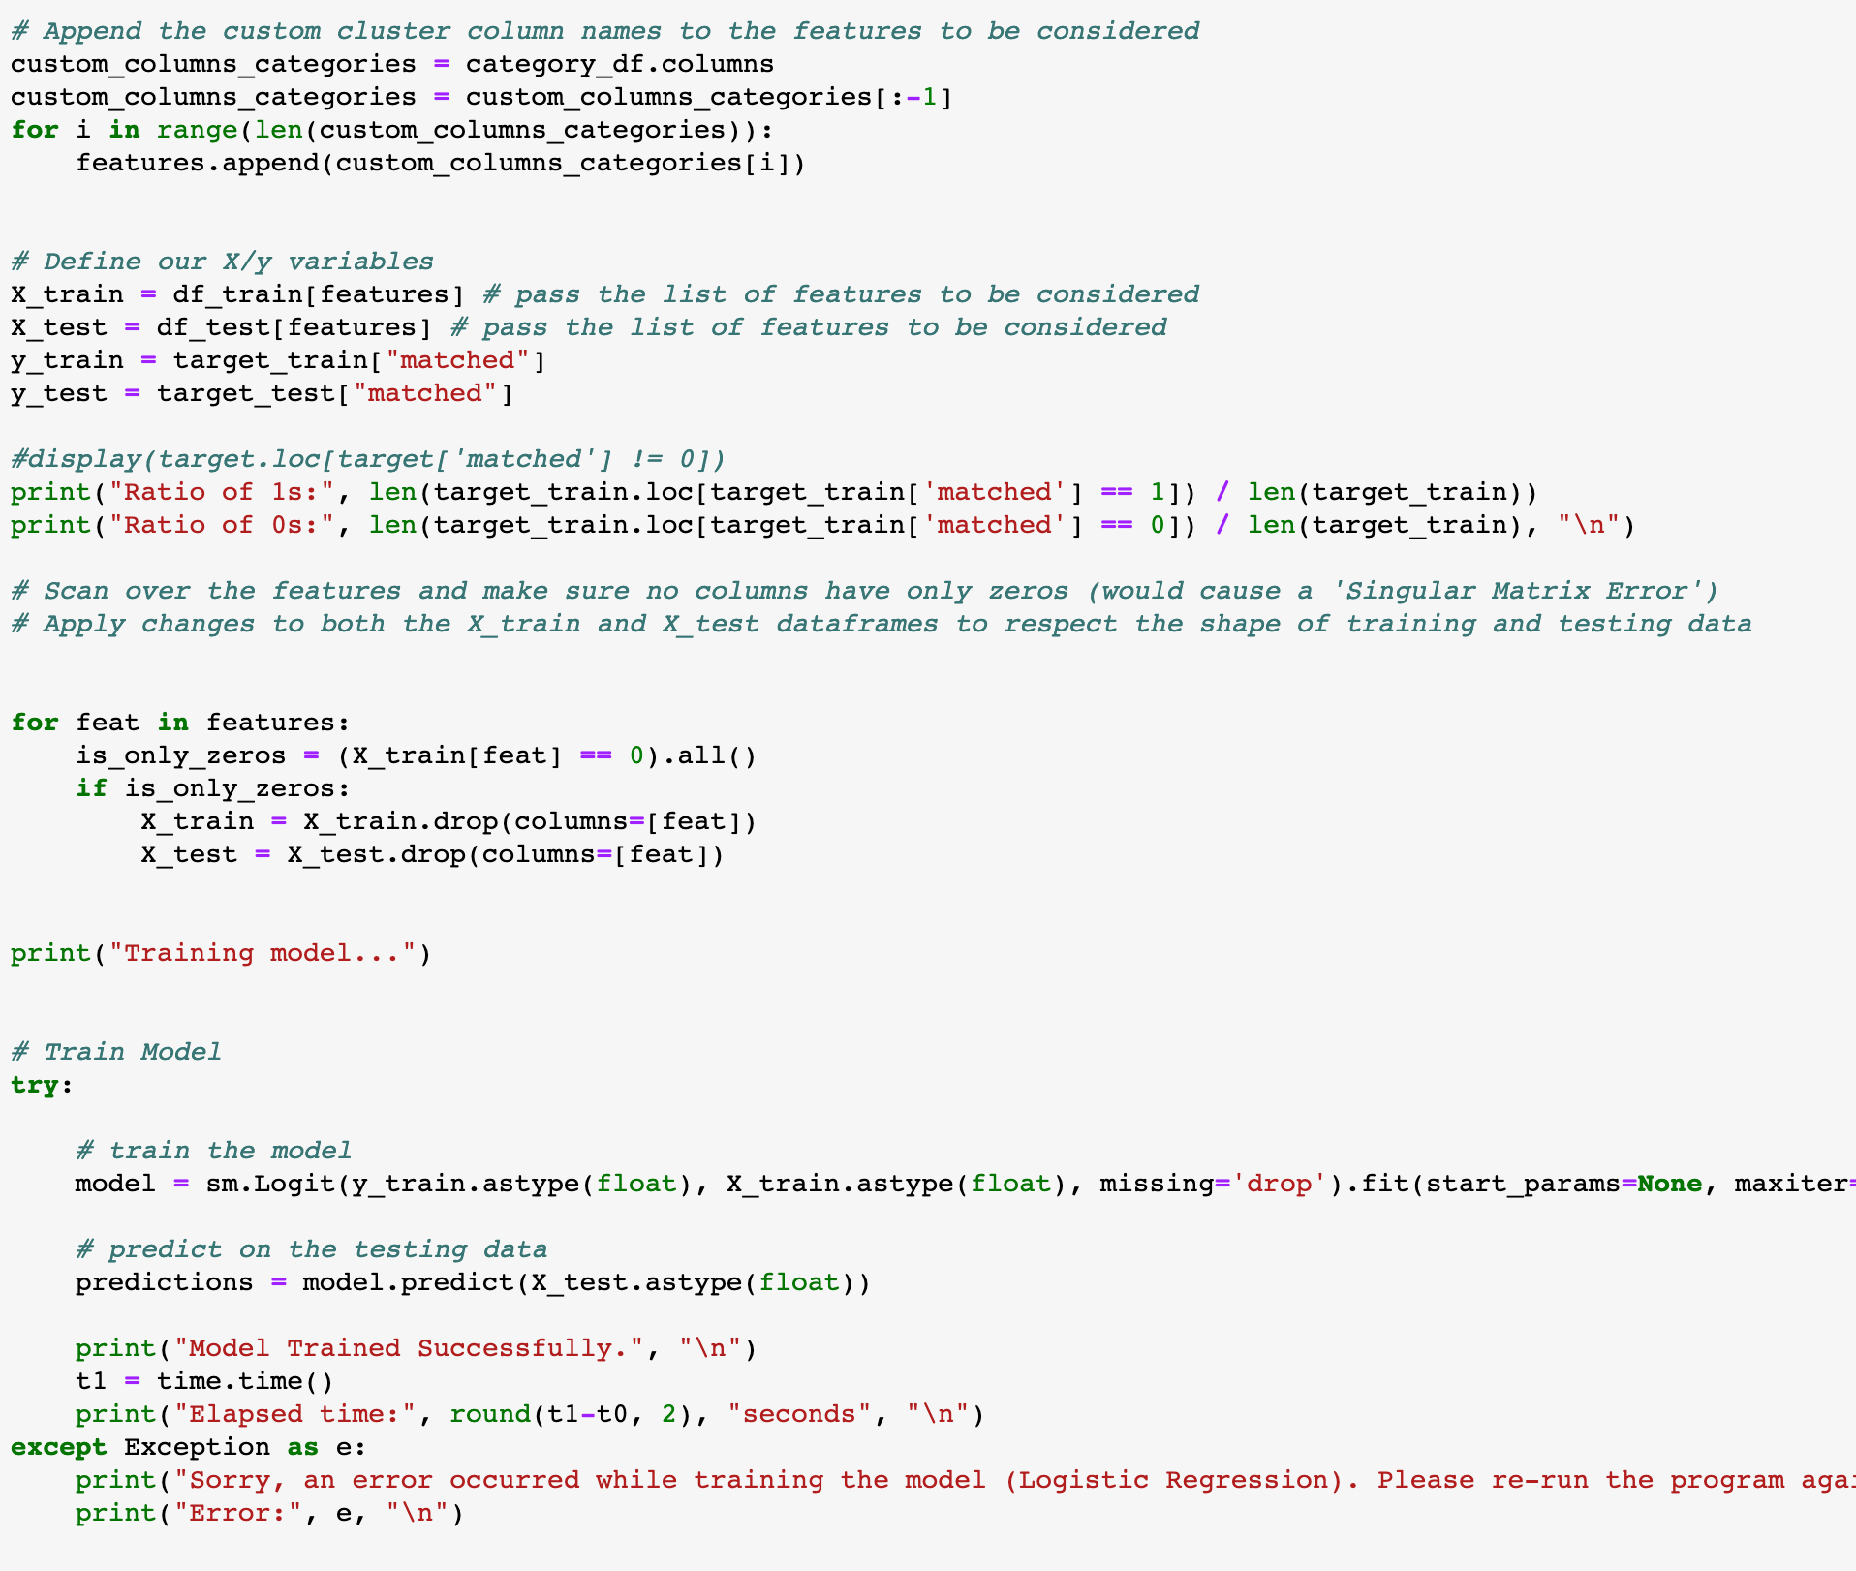
10
Modelling - Logistical Regression
Make sure we have no NaN values in our dataset.
Using the sklearn train_test_split function, we split the training and testing data 70:30 respectively and assign them separate variables.
Dataframe for training data.
Dataframe for testing data.
Here, since the job description cluster columns (as discussed on page 8) are dynamically created, we loop through them and append them to the list of features to be considered by the model.
Set the X variable as all the columns specified by the chosen list of features to consider.
Set the target/Y variable.
Now, we call the statsmodels.Logit() function, passing it the Y and X training variables as floats. For more details on the Logit() and fit() functions, refer to: http://www.statsmodels.org/stable/generated/statsmodels.discrete.discrete_model.Logit.fit.html
We then apply the predict() function to predict the target variable and visualize the classification rate of our model.

Slide 28
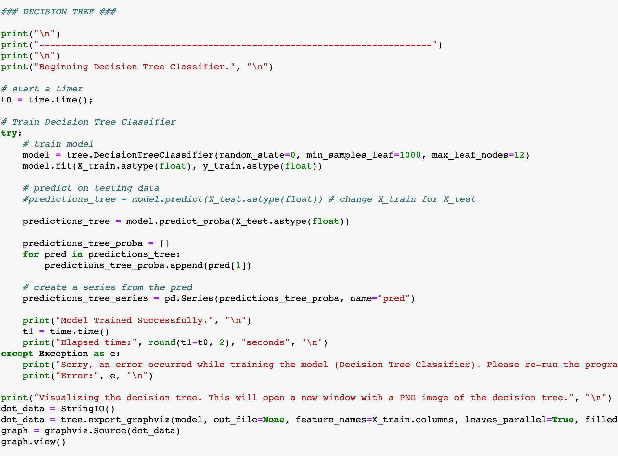
11
Modelling - Decision Tree Classifier
In this section of the code, the same setup variables are used to train the Decision Tree Classifier as the Logistic Regression (i.e.: X_train, X_test, y, df_train, df_test, etc.).
Call the DecisionTreeClassifier() function from the sklearn library.
For more details on the parameters to pass, refer to: https://scikit-learn.org/stable/modules/generated/sklearn.tree.DecisionTreeClassifier.html
Same procedure as described on page 10.
Only difference for the DecisionTreeClassifier is that we must call the .predict_proba() method to get the actual probability values, the .predict() method will return the predicted value only.
For the Decision Tree, we can save a .PDF file of the actual tree generated. The image can be found in the same working directory as “Source.gv.pdf”.

Slide 29
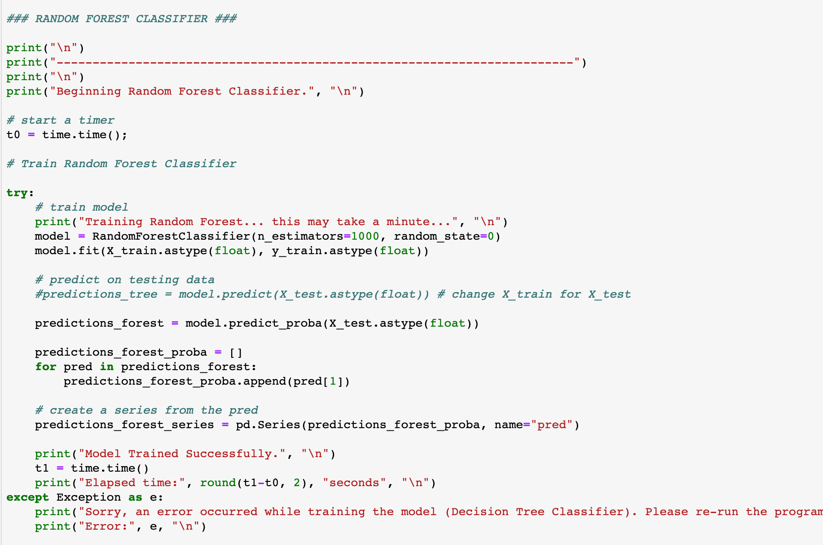
12
Modelling - Random Forest Classifier
In this section of the code, the same setup variables are used to train the Decision Tree Classifier as the Logistic Regression (i.e.: X_train, X_test, y, df_train, df_test, etc.).
Call the RandomForestClassifier() function from the sklearn library with n_estimators=1000.
For more details on the parameters to pass, refer to: https://scikit-learn.org/stable/modules/generated/sklearn.ensemble.RandomForestClassifier.html
Same procedure as described on page 10.
For the random forest classifier, the same procedure to extract the predicted probabilities must be used.

Slide 30
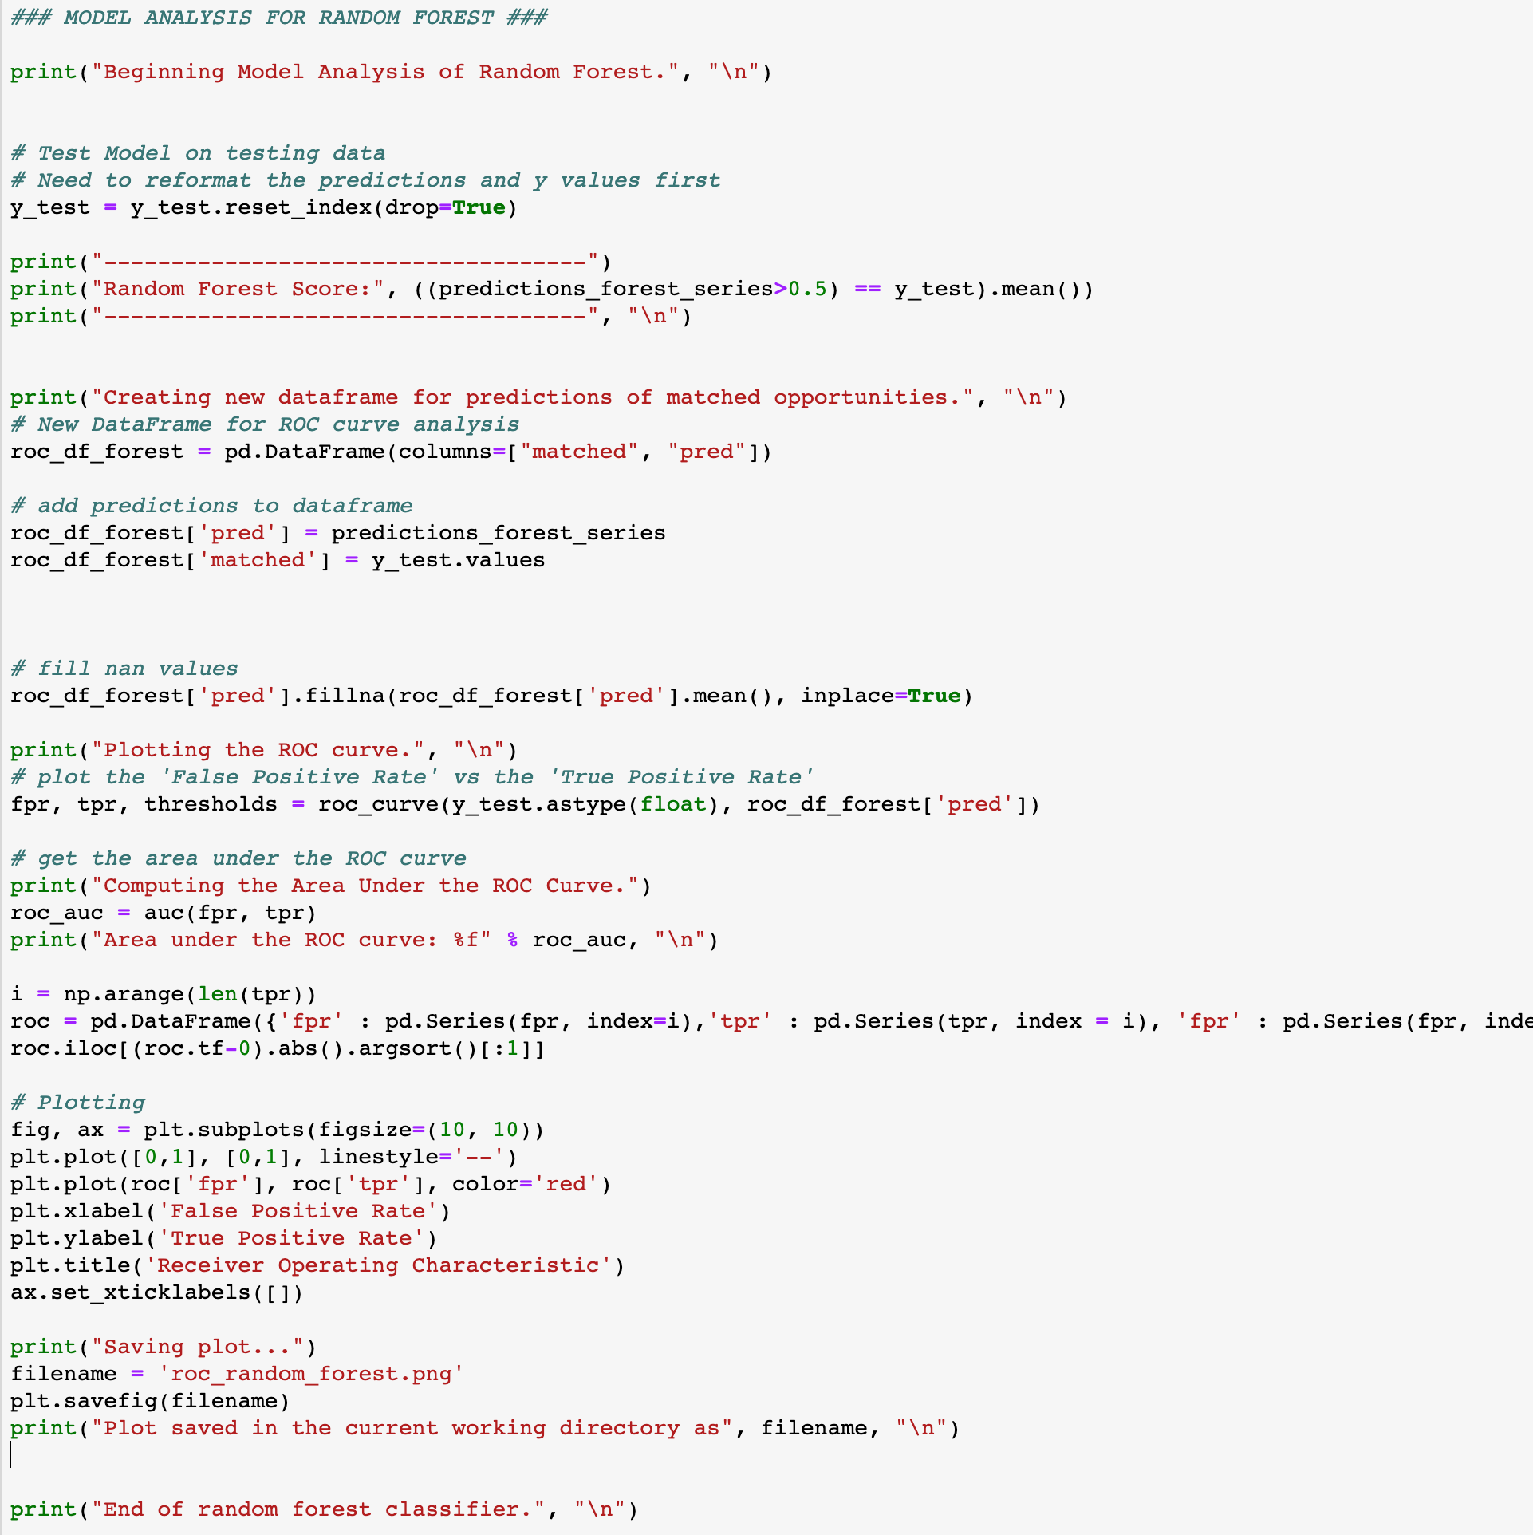
13
Analysis - Classification Rates, ROC curves
To analyze the accuracy of our models, we use a ROC curve.
For more details, visit: https://en.wikipedia.org/wiki/Receiver_operating_characteristic
We generate the predictions of our target variable using our testing data.
The model’s classification score is computed by getting the average of the probability which are greater than our cutoff (here, 0.5) In both the predicted true value for a given row.
Create a dataframe with a matched and pred (as in ”prediction”) and set their values. This will be used to plot the ROC curve.
We plot the True Positive Rate (TPR) vs the False Positive Rate (FPR).
Using the sklearn auc() function, we compute the area under the ROC curve, which is a measure of the model’s reliability. Closer to 1 meaning very accurate (although could also signify overfit).
Using the matplotlib.pyplot library, we illustrate the curves.
We save the ROC curve as a .PNG file in the same working directory as the matcha.py file.
Note: almost exact same code is used to analyze the Logistic Regression and Decision Tree.

Slide 31
End of Appendix

